Slide 1
Analysis and Design of Algorithms
Session -22

Slide 2
Backtracking methodology
Many problems which deal with searching for a set of solutions or for a optimal solution satisfying some constraints can be solved using the backtracking formulation.
In Backtracking method, the desired solution is expressed as an n-tuple vector : (x₁…………… x_{i ……………….}x_{n} ) where x_{i} is chosen from some finite set S_{i}.
The problem is to find a vector, which maximizes or minimizes a criterion function P(x₁…………… x_{i ……………….}x_{n} ).
The major advantage of this method is, once we know that a partial vector(x₁,…x_{i}) will not lead to an optimal solution then the generation of remaining components i.e.,(x_{i+1}………..x_{n}) are ignored entirely.

Slide 3
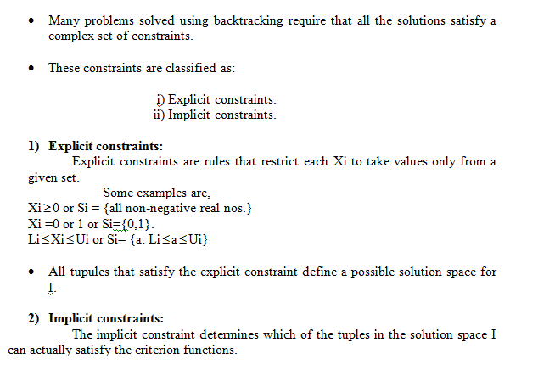

Slide 4
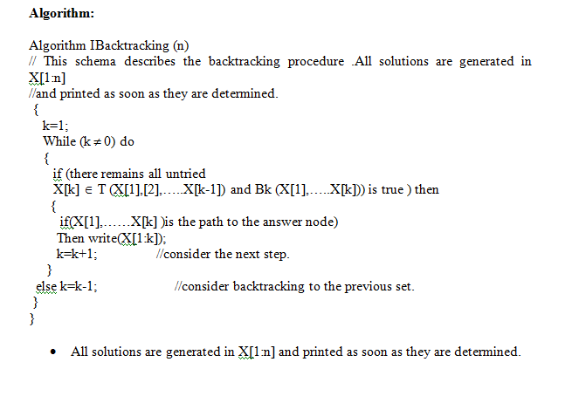

Slide 5
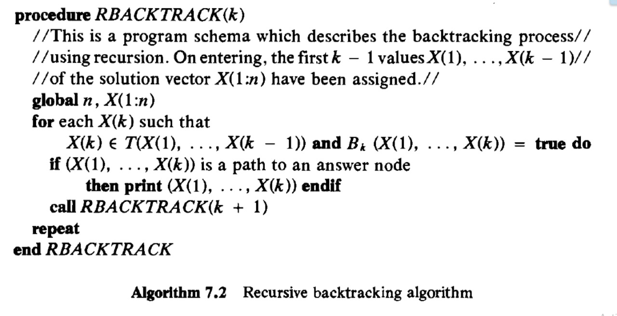

Slide 6
_{State space Tree.}
1
X₁=1
X₁=4
X₁=2
X₁=3
2
34
50
18
x₂=
1
2
4
1
2
3
2
3
4
1
3
4
3
8
13
19
24
29
35
40
45
51
56
61
x₃=
3
4
2
4
2
3
3
4
1
4
1
3
2
4
1
4
1
2
2
3
1
3
1
2
4
6
9
11
14
16
20
22
25
27
30
32
36
38
41
43
46
48
52
54
57
59
62
64
x₄=
4
3
4
2
3
2
4
3
4
1
3
1
4
2
4
1
2
1
3
2
3
1
2
1
5
7
10
12
15
17
21
23
26
28
31
33
37
39
42
44
47
9
53
55
58
60
63
65
Tree organization of the 4-queens solution space. Nodes are numbered as in depth first search.

Slide 7
State Space Tree Terminology
1. Criterion function: It is a function P(X1, X2… X n) which needs to be maximized or minimized for a given problem.
2. Solution Space: All tuples that satisfy the explicit constraints define a possible solution space for a particular instance ‘I’ of the problem
3. Problem state: Each node in the tree organization defines a problem state.
4. Solution States: These are those problem states S for which the path form the root to S define a tuple in the solution space.
5. State space tree: If we represent solution space in the form of a tree then the tree is referred as the state space tree.
6. Answer States: These solution states S for which the path from the root to S defines a tuple which is a member of the set of solution (i.e. it satisfies the implicit constraints) of the problem.

Slide 8
State Space Tree Terminology..contd
7. Live node: A node which has been generated and all of whose children have not yet been generated is live node.
8. E-node: The live nodes whose children are currently being generated is called E-node (node being expanded)
9. Dead node: It is a generated node that is either not to be expanded further or one for which all of its children has been generated.
10. Bounding function: It will be used to kill live nodes without generating all their children
11. Branch and bound: It is a method in which E-node remains E-node until it is dead

Slide 9
Applications of Backtracking
Producing all permutations of a set of values
Parsing languages
3. Games: anagrams, crosswords, word jumbles, 8 queens
Combinatory and logic programming
Example Problems
N queen’s problem
Sum of subsets problem.
Graph colorig problem
0/1 knapsck problem
Hamiltonian cycle problem

Slide 10

4-Queens Problem
Can n queens be placed on an n x n chessboard so that no queen may attack another queen?
Notes:
Problem may be solved in O(n) time by considering the cases: n is odd, n mod 6 = 2, else (n is even and n mod 6 != 2). However, solution eluded researchers for years. Although problem is no longer hard, it was hard for quite a while. See Explicit solutions to the N-queens problem for all N, Bo Bernhardsson, ACM SIGART Bulletin, 2(2), page 7. No placement is possible for n < 4. For n >= 4, the placement is always possible.

